Slide 1
Module – 3
ML Concepts, Algorithms & Model Evaluation
Dr. Rakhee Chhibber

Slide 2
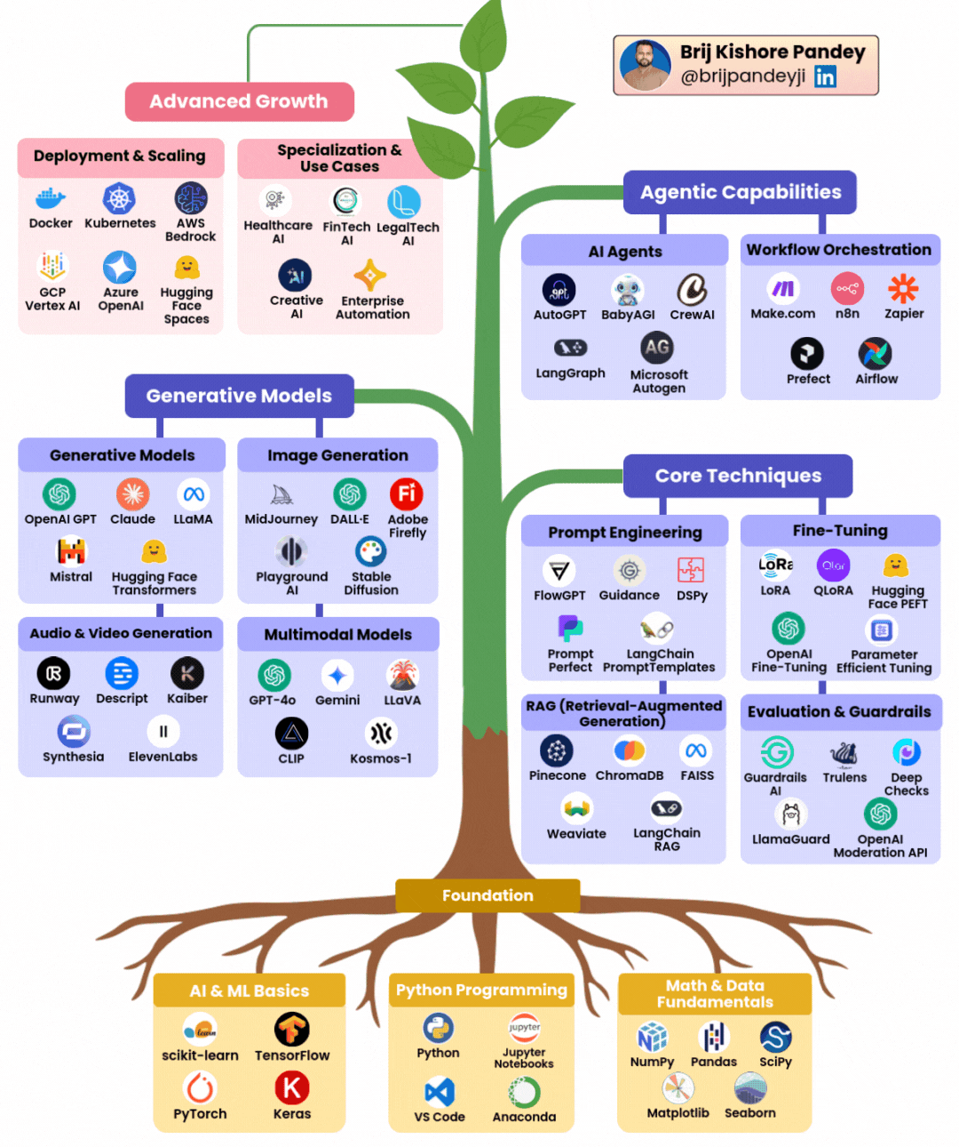
The Skill Tree You need to grow in Gen - AI

Slide 3
Module 3: Machine Learning
1. ML Concepts | 2. ML Algorithms
Supervised vs Unsupervised Semi-supervised Reinforcement learning basics ML workflow Feature engineering Model training, validation, testing Hyperparameter tuning | Linear & Logistic Regression KNN Decision Trees & Random Forest SVM Ensemble Learning KMeans, DBSCAN PCA
3. Model Evaluation | 4. Tools And Assignments
Classification metrics Regression metrics Confusion matrix ROC/AUC | ✔ Scikit-learn, Jupyter Assignments Build regression & classification models Fraud detection model Clustering customer segmentation

Slide 4
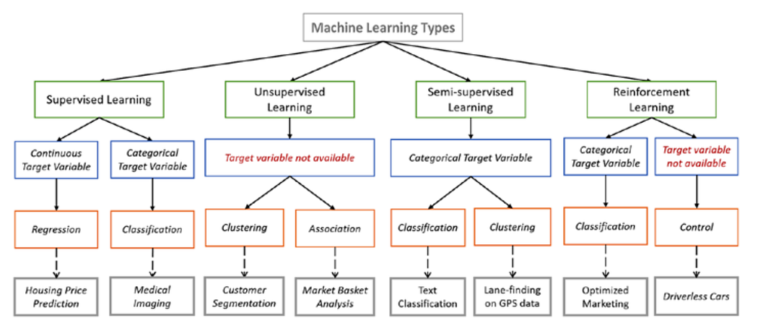

Slide 5
Classification / Logistic Regression

Slide 6
Introduction
Logistic Regression is a supervised machine learning algorithm used for classification problems. Unlike linear regression which predicts continuous values it predicts the probability that an input belongs to a specific class.
It is used for binary classification where the output can be one of two possible categories such as Yes/No, True/False or 0/1.
It uses sigmoid function to convert inputs into a probability value between 0 and 1.

Slide 7
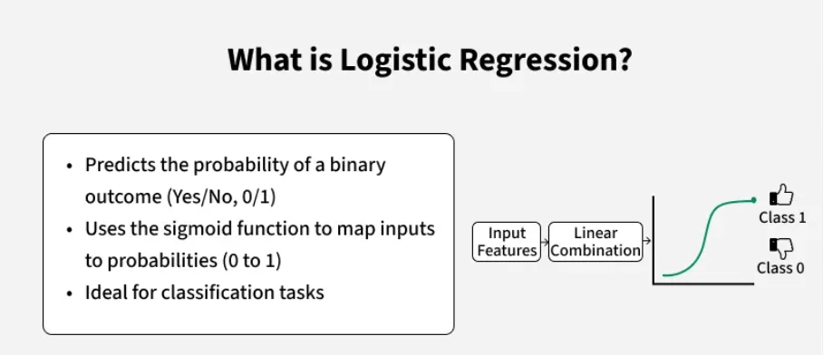

Slide 8
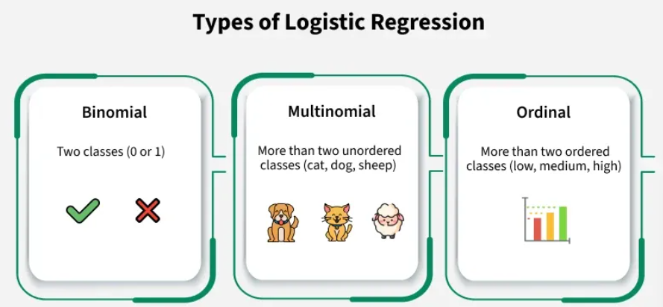

Slide 9
Types of logistic regression
Binomial Logistic Regression: DV has only two possible categories. Examples include Yes/No, Pass/Fail or 0/1. It is the most common form of logistic regression and is used for binary classification problems.
Multinomial Logistic Regression: DV has three or more possible categories that are not ordered. For example, classifying animals into categories like "cat," "dog" or "sheep." It extends the binary logistic regression to handle multiple classes.
Ordinal Logistic Regression: DV has three or more categories with a natural order or ranking. Examples include ratings like "low," "medium" and "high." It takes the order of the categories into account when modeling.

Slide 10
Assumptions of Logistic Regression
Independent observations: Each data point is assumed to be independent of the others. There should be no correlation between the input samples.
Binary dependent variables: dependent variable must be binary, means it can take only two values. For more than two categories SoftMax functions are used.
Linearity relationship between independent variables and log odds: The model assumes a linear relationship between the independent variables and the log odds of the dependent variable which means the predictors affect the log odds in a linear way.
No outliers:
Large sample size: for stable results.

Slide 11
Understanding Sigmoid Function
1. The sigmoid function is used to convert the raw output of the model into a probability value between 0 and 1.
2. This function takes any real number and maps it into the range 0 to 1 forming an "S" shaped curve called the sigmoid curve or logistic curve. Because probabilities must lie between 0 and 1, the sigmoid function is perfect for this purpose.
3. In logistic regression, we use a threshold value usually 0.5 to decide the class label.
  If the sigmoid output is same or above the threshold, the input is classified as Class 1.
  If it is below the threshold, the input is classified as Class 0.

Slide 12
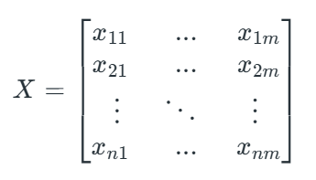
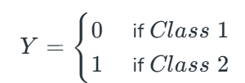
How does Logistic Regression work?
Input Features / independent Variable
Output Variable / Dependent Variable

Slide 13
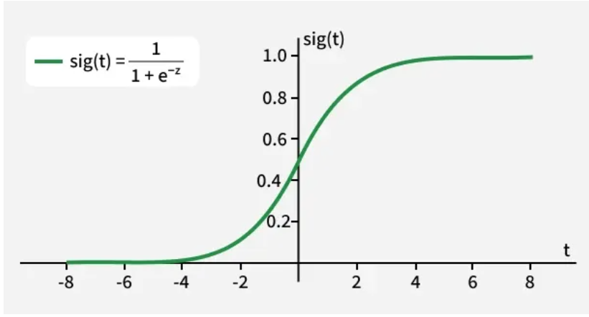
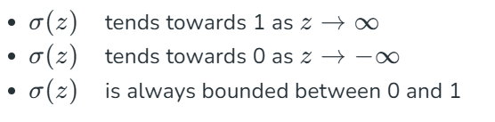

Sigmoid Curve
As shown above the sigmoid function converts the continuous variable data into the probability i.e between 0 and 1.
where the probability of being a class can be measured as:

Slide 14
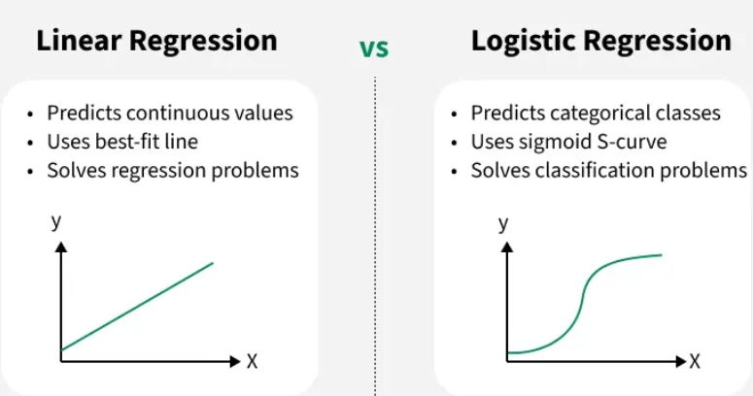

Slide 15
Terminologies involved in Logistic Regression
Independent Variables: are the input features or predictor variables
Dependent Variable: target variable that we aim to predict. This is categorical.
Logistic Function: transforms the independent variables into a probability between 0 and 1 which represents the likelihood that the dependent variable is either 0 or 1.
Odds: ratio of the probability of an event happening to the probability of it not happening.
Log-Odds (Logit): The natural logarithm of the odds. these are modeled as a linear combination of the independent variables and the intercept.
Coefficient: These are the parameters estimated by the logistic regression model which shows how strongly the independent variables affect the dependent variable.
Intercept: The constant term in the logistic regression model which represents the log-odds when all independent variables are equal to zero.
Maximum Likelihood Estimation (MLE): This method is used to estimate the coefficients of the logistic regression model by maximizing the likelihood of observing the given data.

Slide 16
1. Binomial Logistic regression:
In binomial logistic regression, the target variable can only have two possible values such as "0" or "1", "pass" or "fail". The sigmoid function is used for prediction.

Slide 17
from sklearn.datasets import load_breast_cancer
from sklearn.linear_model import LogisticRegression
from sklearn.model_selection import train_test_split
from sklearn.metrics import accuracy_score
X, y = load_breast_cancer(return_X_y=True)
X_train, X_test, y_train, y_test = train_test_split(X, y, test_size=0.20, random_state=23)
clf = LogisticRegression(max_iter=10000, random_state=0)
clf.fit(X_train, y_train)
acc = accuracy_score(y_test, clf.predict(X_test)) * 100
print(f"Logistic Regression model accuracy: {acc:.2f}%")
classify whether a sample from the breast cancer dataset is malignant or benign.
Output
Logistic Regression model accuracy (in %): 96.49%

Slide 18

Evaluation Metrics
For Different ML Algorithm

Slide 19
Metrics
Accuracy: provides the proportion of correctly classified instance
Precision: focuses on the accuracy of positive predictions.
3. Recall (Sensitivity or True Positive Rate): measures the proportion of correctly predicted positive instances among all actual positive instances.
4. F1 Score: is the harmonic mean of precision and recall.
5. Under the Receiver Operating Characteristic Curve (AUC-ROC): The ROC curve plots the true positive rate against the false positive rate at various thresholds. AUC-ROC measures the area under this curve which provides an aggregate measure of a model's performance across different classification thresholds.
6. Area Under the Precision-Recall Curve (AUC-PR): Similar to AUC-ROC, AUC-PR measures the area under the precision-recall curve helps in providing a summary of a model's performance across different precision-recall trade-offs.

Slide 20
Classification Metrics
Confusion Metrics - (Used in Logistic Regression, Decision Tree, Random Forest, XGBoost, SVM, Naive Bayes, Neural Networks)
Actual \ Predicted | Positive | Negative
Positive | TP | FN
Negative | FP | TN
📌 Example (Spam detection):
TP = Spam correctly detected
FP = Email wrongly marked as spam
FN = Spam missed
TN = Legit email correctly classified

Slide 21
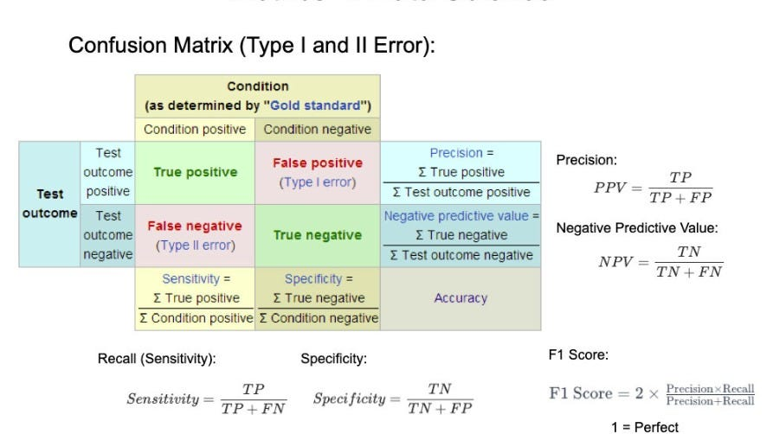


Slide 22
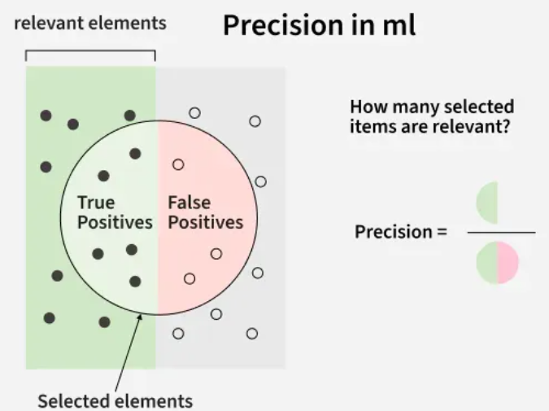

Slide 23
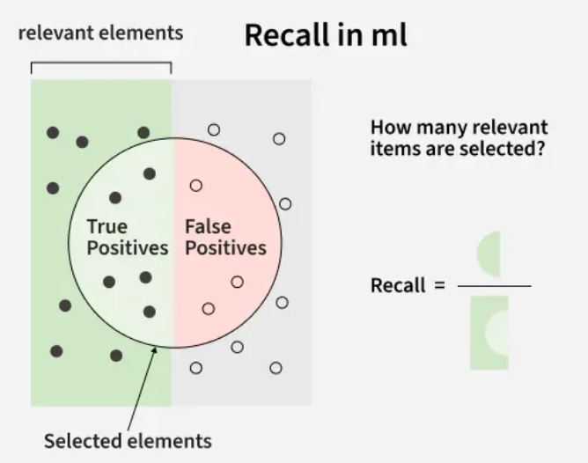

Slide 24
Consider a study where a new diagnostic model (e.g., using chest X-rays) is tested on 1000 patients. [3, 4, 5, 6]
 | Actual COVID-19 Positive | Actual COVID-19 Negative
Predicted Positive | 70 (True Positive) | 30 (False Positive)
Predicted Negative | 10 (False Negative) | 890 (True Negative)
Interpretation of Results
False Positives (FP): 30
  The model incorrectly predicted that 30 healthy people had COVID-19 (Type I error).
False Negatives (FN): 10
  The model incorrectly predicted that 10 people with COVID-19 were healthy (Type II error). This is often considered the most problematic error in a pandemic, as these individuals might unknowingly spread the virus
Accuracy: (TP + TN) / Total = (70 + 890) / 1000 = 96%
Sensitivity (Recall): TP / (TP + FN) = 70 / (70 + 10) = 87.5%
Specificity: TN / (TN + FP) = 890 / (890 + 30) = 96.7%
Precision: TP / (TP + FP) = 70 / (70 + 30) = 70%

Slide 25
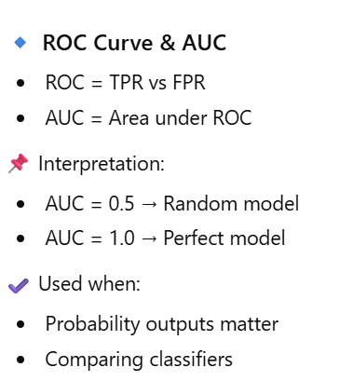
AUC ROC Curve

Slide 26
AUC ROC Curve
It checks how well a binary classification model works and also helps to understand how well the model separates the positive cases like people with a disease from the negative cases like people without the disease at different threshold level.
True Positive Rate (TPR): how often the model correctly predicts the positive cases also known as Sensitivity or Recall.
False Positive Rate (FPR): how often the model incorrectly predicts a negative case as positive.
Specificity: measures the proportion of actual negatives that the model correctly identifies. It is calculated as 1 - FPR.
The higher the curve the better the model is at making correct predictions.

Slide 27
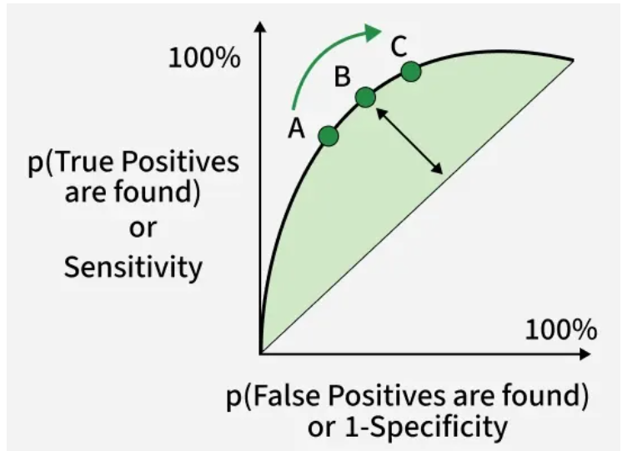
True Positive (TP): Correctly predicted positive instances
True Negative (TN): Correctly predicted negative instances
False Positive (FP): Incorrectly predicted as positive
False Negative (FN): Incorrectly predicted as negative

Slide 28
Problem
Predict whether a customer will buy a product (Yes/No) based on age and income.

Slide 29
Problem Understanding
Business Question:
Can we predict if a customer will purchase a product?
ML Type:
✔ Supervised Learning
✔ Classification Problem

Slide 30
Data Collection
import pandas as pd
data = {
"Age": [22, 25, 47, 52, 46, 56, 30],
"Income": [15000, 30000, 120000, 110000, 80000, 150000, 40000],
"Purchased": [0, 0, 1, 1, 1, 1, 0]
}
df = pd.DataFrame(data)
df

Slide 31
Data Cleaning
✔ Check missing values
✔ Check data types
df.info()
df.isnull().sum()
👉 No missing values → no cleaning needed here
(Real datasets often need imputation, duplicates removal, format fixing)

Slide 32
Exploratory Data Analysis (EDA)
import matplotlib.pyplot as plt
plt.scatter(df["Age"], df["Income"])
plt.xlabel("Age")
plt.ylabel("Income")
plt.show()
Insights
Higher income → higher chance of purchase
Age also influences buying behavior

Slide 33
Feature Engineering
Split features & target
X = df[["Age", "Income"]]
y = df["Purchased"]
Feature Scaling (important for ML models)
from sklearn.preprocessing import StandardScaler
scaler = StandardScaler()
X_scaled = scaler.fit_transform(X)

Slide 34
Model Selection
We choose:
✔ Logistic Regression
(Simple, interpretable, good for binary classification)

Slide 35
Model Training
from sklearn.model_selection import train_test_split
from sklearn.linear_model import LogisticRegression
X_train, X_test, y_train, y_test = train_test_split(
X_scaled, y, test_size=0.2, random_state=42
)
model = LogisticRegression()
model.fit(X_train, y_train)

Slide 36
Validation & Testing
from sklearn.metrics import accuracy_score, classification_report
y_pred = model.predict(X_test)
print("Accuracy:", accuracy_score(y_test, y_pred))
print(classification_report(y_test, y_pred))
✔ Evaluates how well model performs on unseen data

Slide 37
Hyperparameter Tuning
from sklearn.model_selection import GridSearchCV
params = { "C": [0.01, 0.1, 1, 10]}
grid = GridSearchCV(LogisticRegression(), params, cv=3)
grid.fit(X_train, y_train)
print("Best Parameter:", grid.best_params_)
✔ Finds best regularization strength
✔ Improves model performance

Slide 38
Deployment & Monitoring (Basic Example)
Save Model
import joblib
joblib.dump(model, "purchase_model.pkl")
joblib.dump(scaler, "scaler.pkl")

Slide 39
Load & Predict (Deployment Simulation)
model = joblib.load("purchase_model.pkl")
scaler = joblib.load("scaler.pkl")
new_customer = [[35, 60000]]
new_customer_scaled = scaler.transform(new_customer)
prediction = model.predict(new_customer_scaled)
print("Purchased?" , prediction)
Output - Purchased? [1]
✔ In real life → Flask / FastAPI / Cloud
✔ Monitoring → accuracy drift, data drift

Slide 40
Implementation using two different models
import numpy as np
import pandas as pd
import matplotlib.pyplot as plt
from sklearn.datasets import make_classification
from sklearn.model_selection import train_test_split
from sklearn.linear_model import LogisticRegression
from sklearn.ensemble import RandomForestClassifier
from sklearn.metrics import roc_curve, auc

Slide 41
2. Generating data and splitting data
X, y = make_classification(
n_samples=1000, n_features=20, n_classes=2, random_state=42)
X_train, X_test, y_train, y_test = train_test_split(
X, y, test_size=0.2, random_state=42)

Slide 42
3. Training the different models
To train the Random Forest and Logistic Regression models we use a fixed random seed to get the same results every time we run the code. First we train a logistic regression model using the training data. Then use the same training data and random seed we train a Random Forest model with 100 trees.
logistic_model = LogisticRegression(random_state=42)
logistic_model.fit(X_train, y_train)
random_forest_model = RandomForestClassifier(n_estimators=100, random_state=42)
random_forest_model.fit(X_train, y_train)

Slide 43
4. Predictions
Using the test data and a trained Logistic Regression model the code predicts the positive class's probability. In a similar manner, using the test data, it uses the trained Random Forest model to produce projected probabilities for the positive class.
y_pred_logistic = logistic_model.predict_proba(X_test)[:, 1]
y_pred_rf = random_forest_model.predict_proba(X_test)[:, 1]

Slide 44
5. Creating a dataframe
Using the test data the code creates a DataFrame called test_df with columns labeled "True," "Logistic" and "RandomForest," add true labels and predicted probabilities from Random Forest and Logistic Regression models.
test_df = pd.DataFrame(
{'True': y_test, 'Logistic': y_pred_logistic, 'RandomForest': y_pred_rf})

Slide 45
6. Plotting ROC Curve for models
Plot the ROC curve and compute the AUC for both Logistic Regression and Random Forest. The ROC curve compares models based on True Positive Rate vs False Positive Rate, while the red dashed line shows random guessing
plt.figure(figsize=(7, 5))
for model in ['Logistic', 'RandomForest']:
fpr, tpr, _ = roc_curve(test_df['True'], test_df[model])
roc_auc = auc(fpr, tpr)
plt.plot(fpr, tpr, label=f'{model} (AUC = {roc_auc:.2f})')
plt.plot([0, 1], [0, 1], 'r--', label='Random Guess')
plt.xlabel('False Positive Rate')
plt.ylabel('True Positive Rate')
plt.title('ROC Curves for Two Models')
plt.legend()
plt.show()

Slide 46
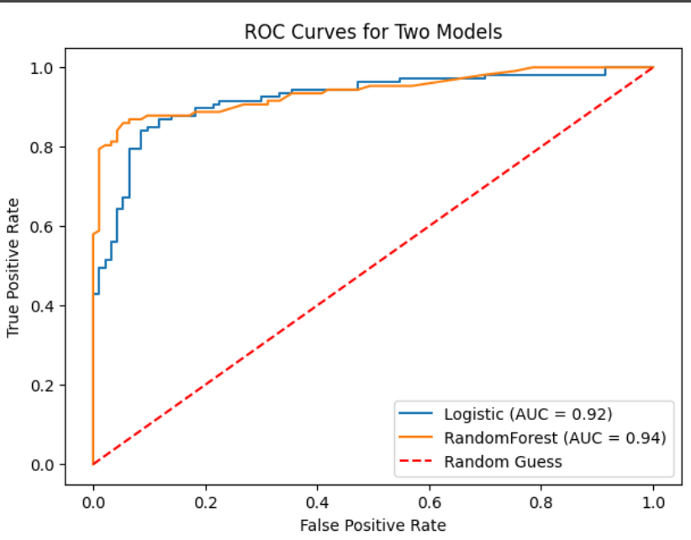

Slide 47
Thank you

